Slide 1



Genres Prediction from Movie Poster
Presented By: Group 4
Arundhadhi Balagopalan (B2020069)
Karan Jaiswal (B2020084)
Vineeth Nair (B2020090)
Souvik Das (B2020118)
Tarun Thomas (B2020119)

Slide 2
Problem Statement
A movie usually belongs to multiple genre that means more than one genre and not necessarily belong to one category like drama or thriller.
We require a classification model that would predict each genre associated with the movie by analyzing its poster

Slide 3
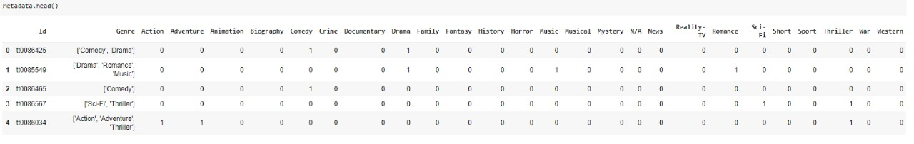
Dataset
This dataset contains posters from IMDB website. Poster image contains mostly Hollywood movies released from 1980 to 2015.
Each poster image is associated with a movie name as well as some metadata like ID, genres. The ID of each image is set as its file name.
The dataset contains 7254 rows and 27 columns along with the movie’s posters.

Slide 4
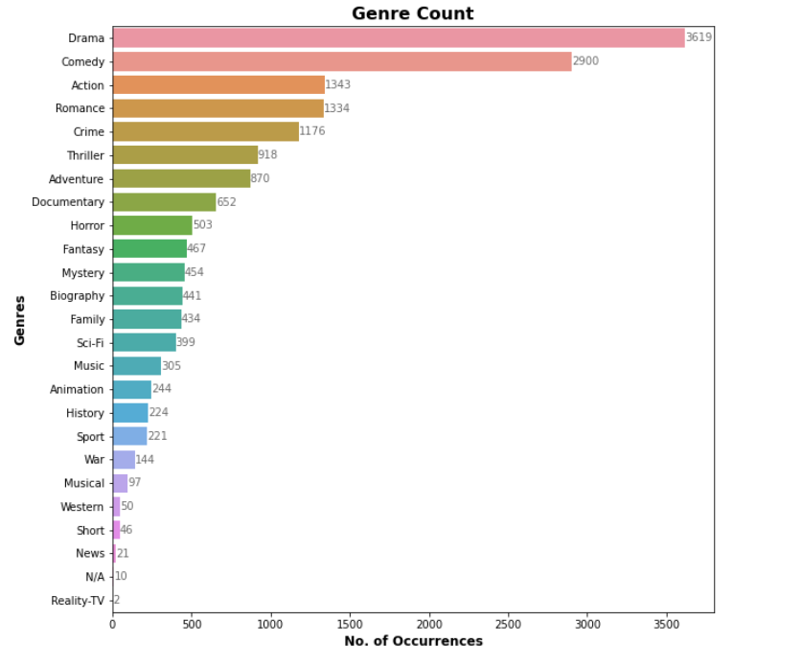
Data Preprocessing
Conversion of each image into fixed size- 350x350
Normalization of values by dividing by 255
Storing the 7254 images in NumPy array
Visualizing occurrences of a particular genre
From the graph, it is clear that the
Drama Category has maximum count
Which is about 3619 followed by
Comedy – 2900 and Action – 1343

Slide 5
Model Building
Model used: Convolutional Neural Network
Training testing split: 70:30
The main application of CNN is image classification.
The model contains:
Input layer
Output layer
Hidden layers
Activation function for hidden layers: Relu
Activation function for output layer: Softmax
Optimization function: Adam
Loss function: Binary Cross Entropy

Slide 6
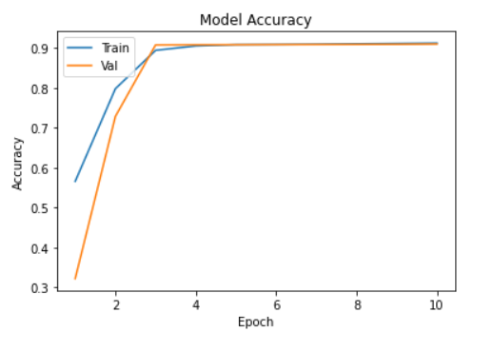
Model Evaluation
Model Accuracy
The validation accuracy (around 90%) is almost same with the training accuracy.

Slide 7
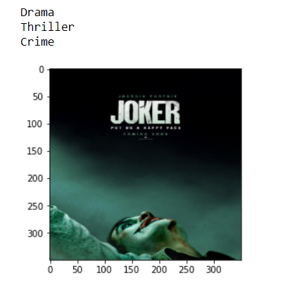
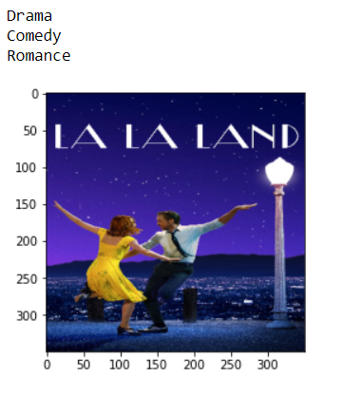
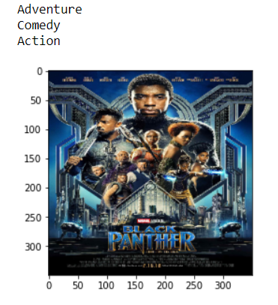
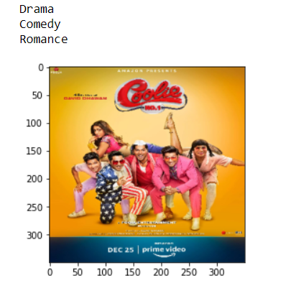
Result
The model predicts the top 3 genres for the above movies

Slide 8
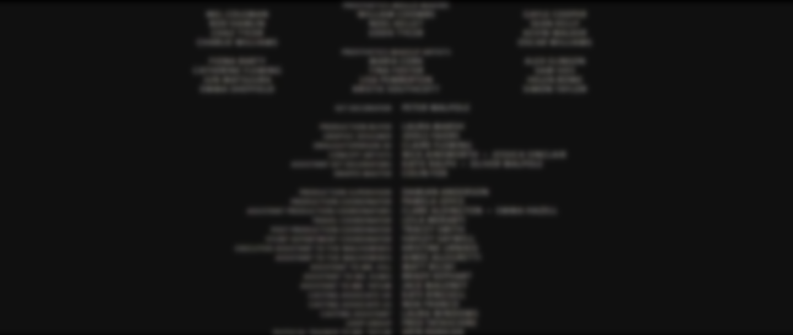
THANK YOU
This Photo by Unknown Author is licensed under CC BY-SA

